Slide 1
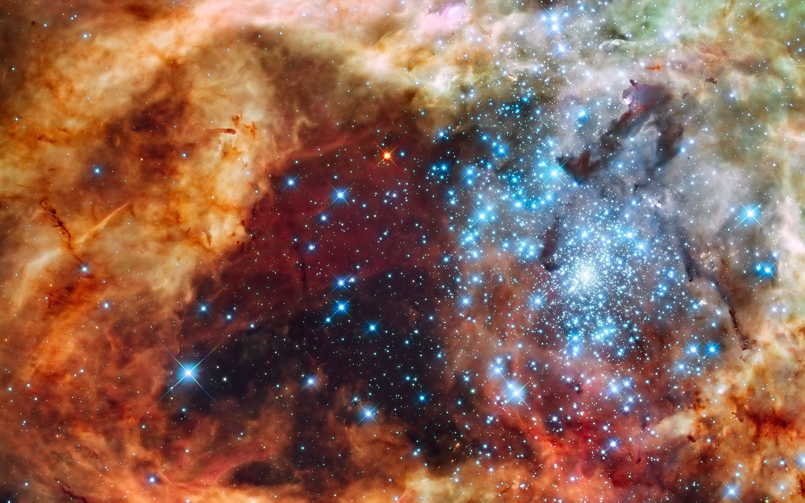
Globular Cluster vs Dark Matter Particle
Kaleb Cruz

Slide 2
Agenda
What is a globular cluster
Dark matter
Earth’s orbit
This project
Conclusion

Slide 3
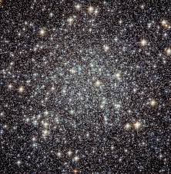
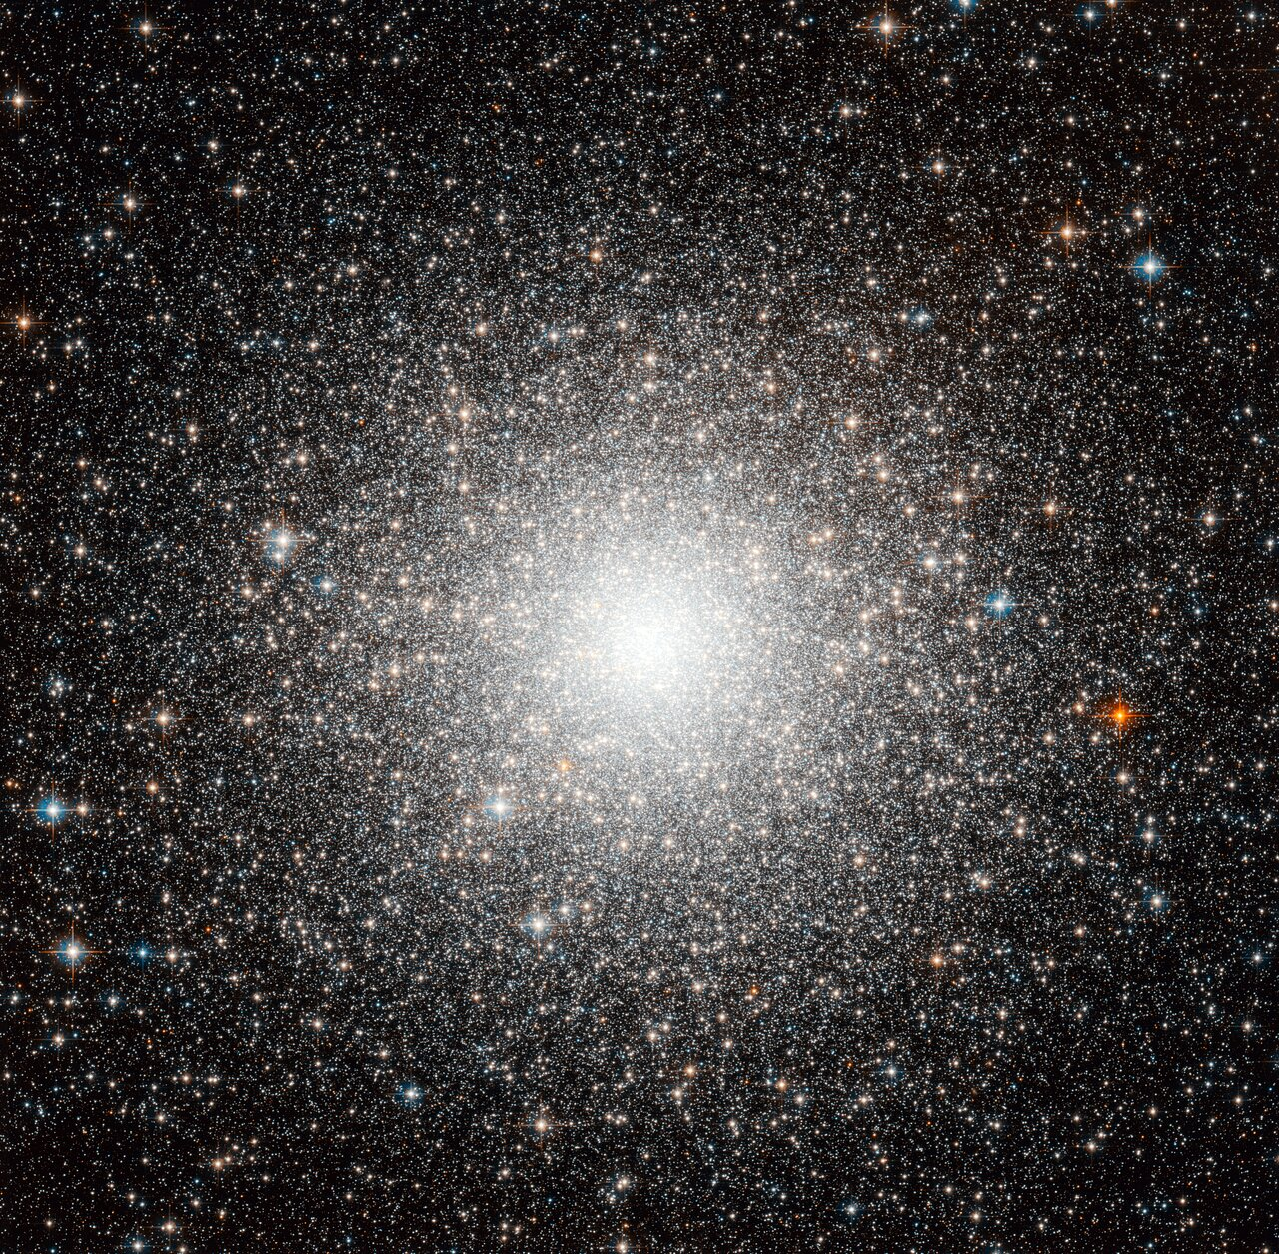
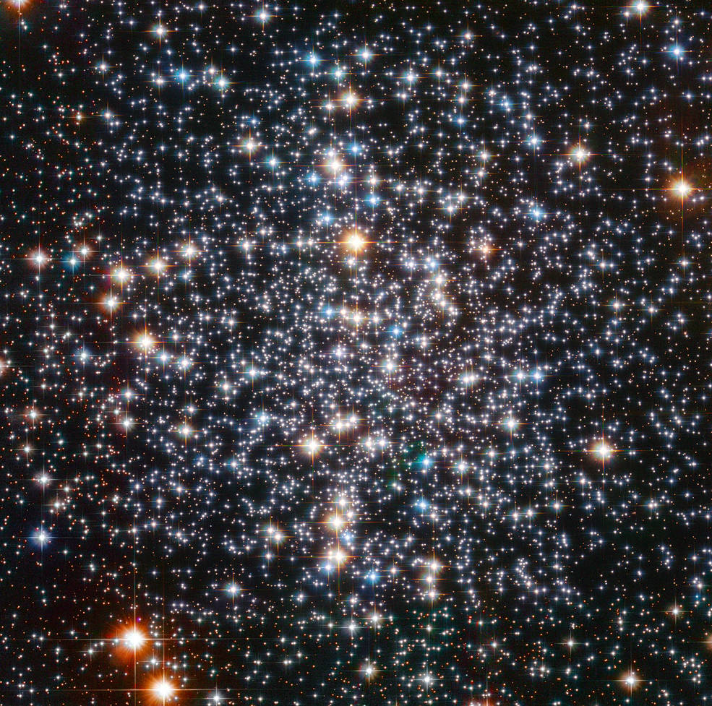
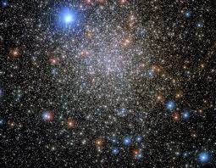
Globular Clusters
A collection of stars formed in the early days of the universe.
They started out as area with extreme amount of gasses.
No new globular clusters can form.
Because of this, we can use them to estimate the age of the universe
Cannot contain planets due to volatile conditions.
Good to study structures of matter in larger scales.
It is also hypothesized that there is no dark matter present
The first one found is M22 in 1665 by Abraham Ihle.
There is approximately 150 globular clusters known in the Milky Way.
There is also roughly 500 in the Andromeda galaxy.
Messier 22
Messier 54
Messier 4
NGC 6717

Slide 4
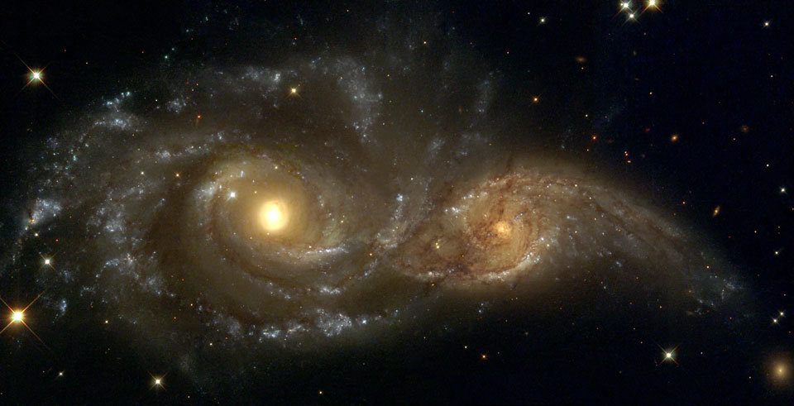
Dark matter
Dark matter does not absorb, reflect or emit light
Dark matter does have an effect on objects nonetheless
The matter affects the path of light which is known as gravitational lensing
There are a lot of different hypothesis on what dark matter is and what it actually does
Globular clusters are used to study the phenomenon
Some believe the clusters are home to dense amounts of it, some believe the clusters are devoid of it
Galaxies NGC 2207 and IC 2163 colliding

Slide 5
Earths Orbit
Earths orbit is an example of a hyperbolic function
Earth’s velocity is not fast enough to escape the gravitational pull of the sun
However, the path of orbit changes due to Jupiter and Saturn’s gravitational pull

Slide 6

This Project
Like previously stated, Earths orbit is an example of a hyperbolic function
The angle that one object travels pass another depends on the mass of both and how fast one is traveling
A dark matter particle should travel in a similar path
This project was supposed to show this
However, I couldn’t get the code to run and plot this kind of relationship
The angle of deflection $Cot\left(\frac{φ}{2}\right)=\frac{hv^{2}}{GM}$

Slide 7
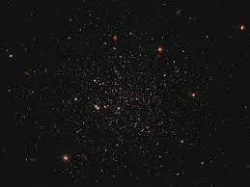
Conclusion
Globular clusters are very useful in studying large formations of matter
Dark matter can be used to study possible effects on a cluster
Any planet’s orbit can be used as an example of this relationship
I enjoyed learning about globular clusters and though my code doesn’t work I still learned a lot.
Leavens 1

